Slide 1
Smart LED Thermometer
Tommaso Mattei

Slide 2
What is Smart LED thermometer?
Smart LED thermometer is a thermometer endowed with a sensor, a LCD screen and some LEDs

Slide 3
What is Smart LED thermometer?
Smart LED thermometer is a thermometer endowed with a sensor, a LCD screen and some LEDs
The main idea is to detect temperature and humidity to show on the LCD screen

Slide 4
What is Smart LED thermometer?
Smart LED thermometer is a thermometer endowed with a sensor, a LCD screen and some LEDs
The main idea is to detect temperature and humidity to show on the LCD screen
At the same time, based on certain ranges of temperature, one of the three LEDs (blue, yellow and red) will light up

Slide 5
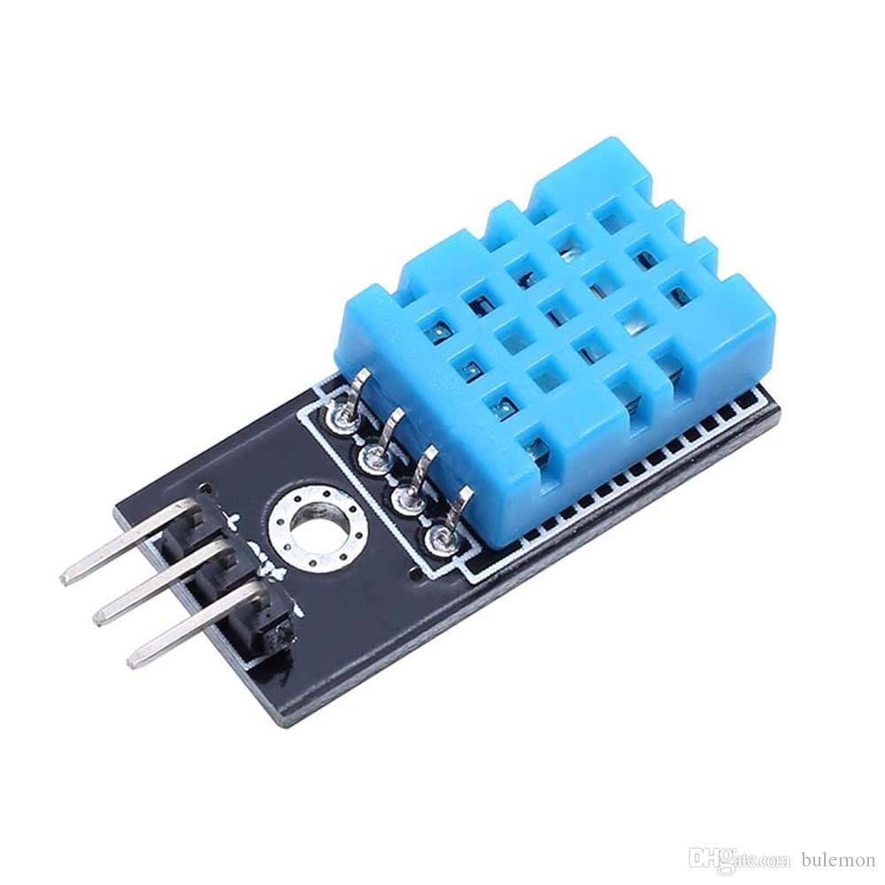

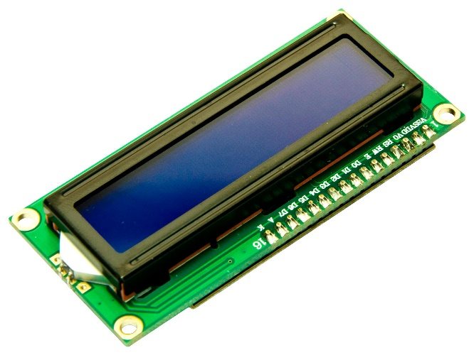
Main components needed for the project
Humidity/temperature sensor
LEDs
LCD screen

Slide 6
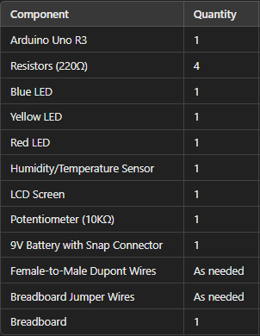
Complete list of components

Slide 7
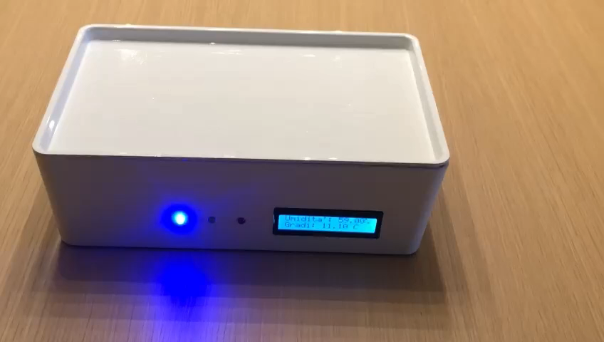
Smart LED Thermometer at work

Slide 8
Thank you for the attention!

